Slide 1
Risk management
doc. Ing. Petr Řehoř, Ph.D.

Slide 2
Learning outcomes
you will know the basic concepts concerning the theme,
you will learn how the process of the risk management takes an airing,
you will know the kinds of risks,
you will get information, what is matrix of the evaluation of risks,
you will name the possibilities of the prevention of risks,
you will be able to run the risks well .

Slide 3
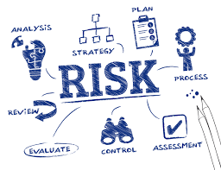
Introduction
Every realized change in the company brings some risk.
Risk can cause the firms damage or high losses.
How to prevent the risks or to reduce them or to eliminate?

Slide 4
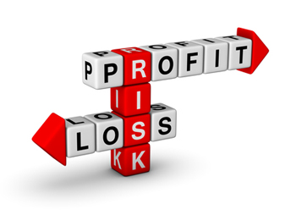
Risk
attribute of an event
effect of uncertainty on objectives
vulnerability
threat
opportunity
impact among other
terms

Slide 5
Risk management
comprehensive and integrated framework for managing company-wide risk in order to maximise a company’s value
enterprise level risk management increasing attention, high-level accountability, and clear responsibilities

Slide 6
Benefits of risk management
Increase the likelihood of a business realising its objectives.
Build confidence in stakeholders and the investment community.
Comply with relevant legal and regulatory requirements.
Align risk appetite and strategy.
Embed the risk process throughout the organisation.
Minimise operational surprises and losses.

Slide 7
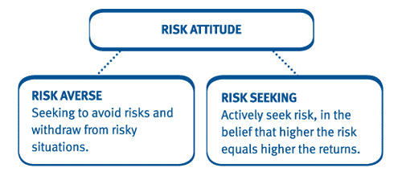
Approaches to risk
Top down
Bottom-up
Mixed

Slide 8
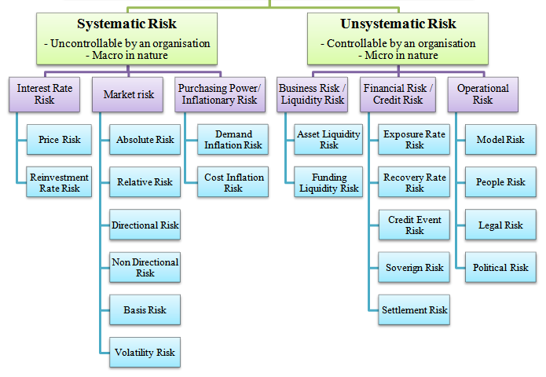
Types of risk

Slide 9
Risk management process
Assessing risk is determining which, if any, are present.
Categorize the risk - risk can be minor or severe.

Slide 10
Risk management process
Consider your options.
Implement your strategy.

Slide 11
Quantitative and qualitative risk analysis
Qualitative risk analysis requires that the probability and consequences of the risk be evaluated using established qualitative-analysis methods and tools.
Quantitative assessment is particularly used to forecast potential project schedule and cost results listing the associated confidence level for each potential value of the considered value.

Slide 12
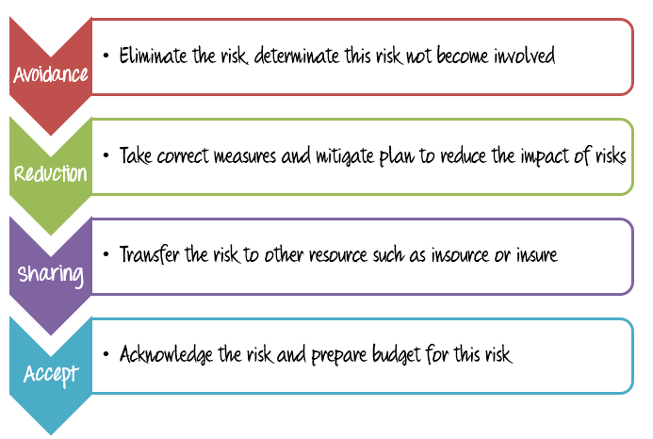
Risk management strategies
Loss controlling
Risk accepting
Risk steering
Diversifying

Slide 13
Thank you for
the attenttion!!!

