Slide 1
Leader of change 4.O Industry
doc. Ing. Petr Řehoř, Ph.D.

Slide 2
Learning outcomes
you will know about the leader of change,
you will learn about concept 4.0 Industry.

Slide 3
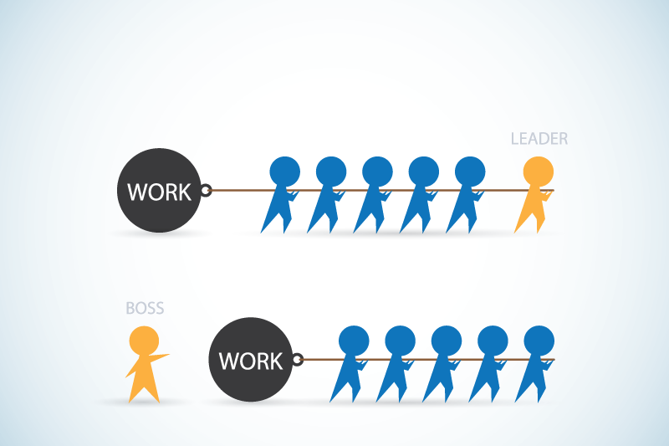
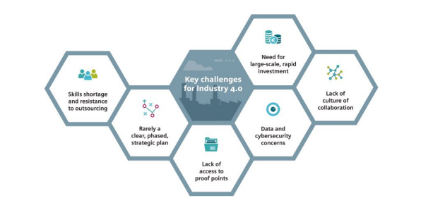
Introduction
Leader is a person who influence the people or the group towards achievement of goal.
The emotional approach to organizational change – charismatic and transformational leadership.
Industry 4.0 is a name given to the current trend of automation and data exchange in manufacturing technologies.

Slide 4
Manager vs. leader
Manager plans the details, minimizes risks, instructs employees, has objectives, meets expectations, eyes the bottom line, accepts the status quo, sees a problem, thinks short-term, follows the map, approves, establishes rules, assigns duties, votes with their head, relies on control and does things right.
Leader sets the direction, takes risks, encourages people, has vision, charts new growth, eyes the horizon, challenges the status quo, sees an opportunity, thinks long-term, carves new roads, motivates, breaks rules, fosters ideas, votes with their heart, inspires trust and does the right thing

Slide 5
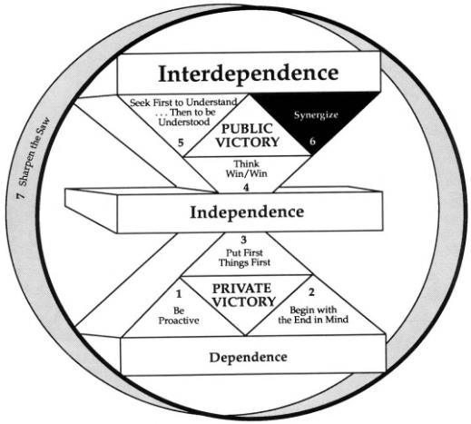
7 Habits of leadership
S.R.Covey

Slide 6
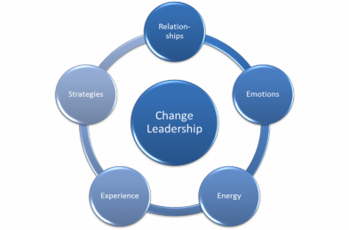
Change leadership
The ability to energize groups who will be implementing change projects that they may or may not buy into.
Defining areas for change; managing change initiatives smoothly by anticipating, preparing and responding effectively to roadblocks; creating an open, receptive work environment; and involving people at all
levels in the change
initiative.

Slide 7
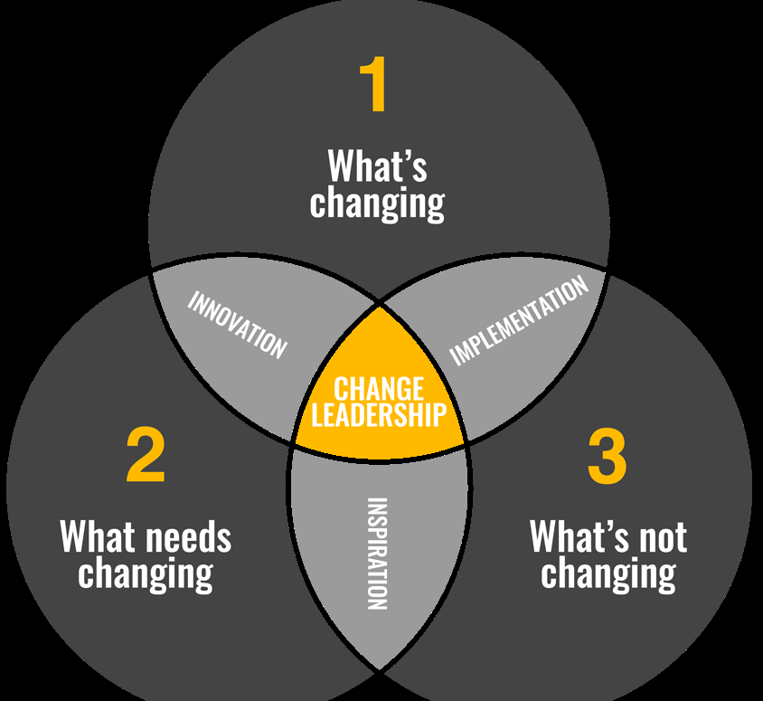
Change leader
Must go beyond storytelling, motivation, and mobilization efforts―they need to provide resources so that the organization has what it needs to win in the new environment. This might include capital improvements, process improvements, and building new talent
capabilities.

Slide 8
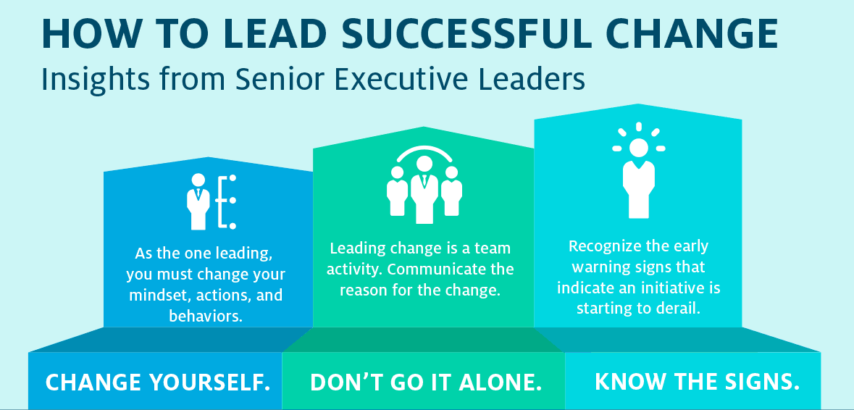
Change leaders
Six characteristics of highly effective:
Low level of anxiety
Emotional stability
Action orientation
Confidence
Openness
Risk
tolerance

Slide 9
Change leader
3C:
Communicate - successful leaders communicated the “what” and the “why.”
Collaborate - successful leaders worked across boundaries, encouraged employees to break out of their silos and refused to tolerate competition.
Commit - successful leaders made sure their own beliefs and behaviors supported change, too.

Slide 10
Industry 4.0
A collective term for technologies and concepts of value chain organization. Based on the technological concepts of cyber-physical systems, the Internet of Things and the Internet of Services, it facilitates the vision of the Smart Factory.
Within the modular structured Smart Factories of Industry 4.0, cyber-physical systems monitor physical processes, create a virtual copy of the physical world and make decentralized decisions.

Slide 11
Building blocks of Industry 4.0
Industry 4.0
Autonomous Robots
Simulation
Horizontal and vertical system integration
Additive Mfg
Industrial Internet of Things
Augmented reality
Big data analytics
Cyber Security

Slide 12
6 design principles of Industry 4.0
Interoperability: the ability of cyber-physical systems (i.e. work piece carriers, assembly stations and products), humans and Smart Factories to connect and communicate with each other via the Internet of Things and the Internet of Services.
Virtualization: a virtual copy of the Smart Factory which is created by linking sensor data (from monitoring physical processes) with virtual plant models and simulation models.
Decentralization: the ability of cyber-physical systems within Smart Factories to make decisions on their own.

Slide 13
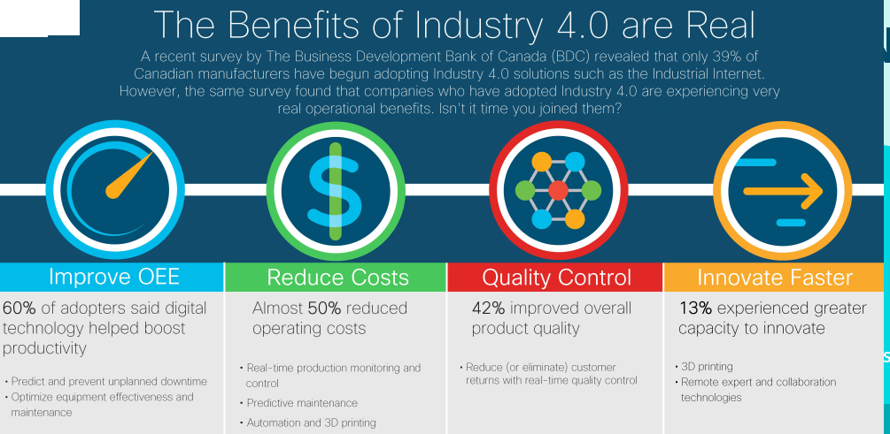
6 design principles of Industry 4.0
Real-Time Capability: the capability to collect and analyze data and provide the insights immediately.
Service Orientation: offering of services (of cyber-physical systems, humans and Smart Factories) via the Internet of Services.
Modularity: flexible adaptation of Smart Factories for
changing requirements
of individual modules.

Slide 14
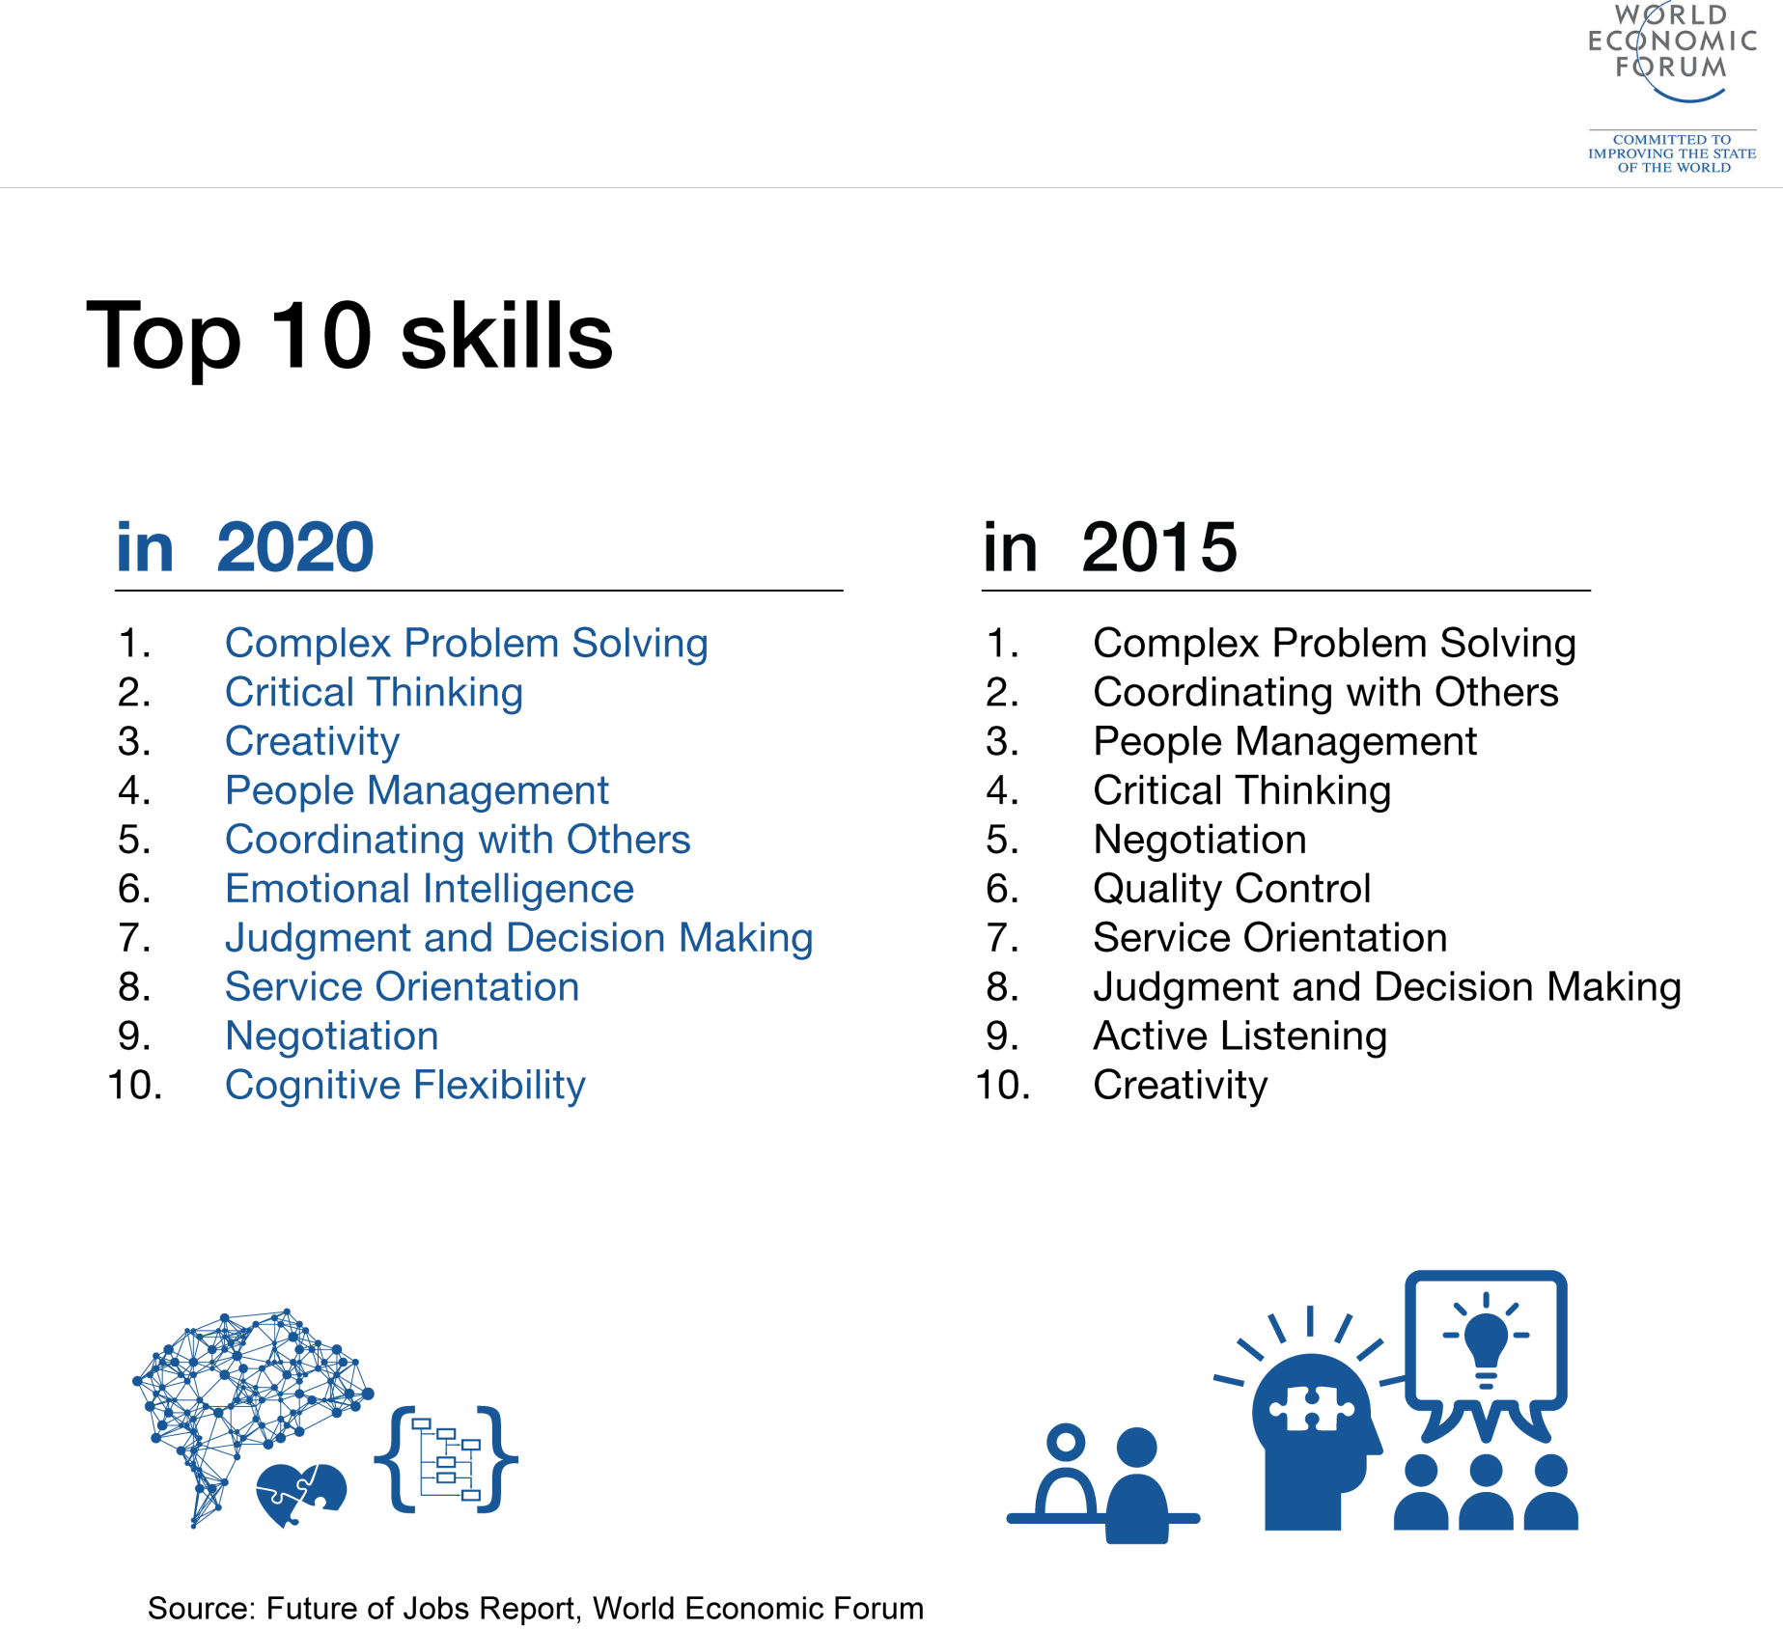
10 skills in industry 4.0

Slide 15
Challenges in implementation of Industry 4.0
IT security issues, which are greatly aggravated by the inherent need to open up those previously closed production shops
Reliability and stability needed for critical machine-to-machine communication (M2M), including very short and stable latency times
Need to maintain the integrity of production processes
Need to avoid any IT snags, as those would cause expensive production outages
Need to protect industrial know how (contained also in the control files for the industrial automation gear)

Slide 16
Challenges in implementation of Industry 4.0
Threat of redundancy of the corporate IT department
General reluctance to change by stakeholders
Loss of many jobs to automatic processes and IT-controlled processes, especially for lower educated parts of society
Low top management commitment
Unclear legal issues and data security
Unclear economic benefits/ Excessive investment
Lack of regulation, standard and forms of certifications
Insufficient qualification of employees
Lack of adequate skill-sets to expedite the march

Slide 17
Thank you for
the attenttion!!!

