Slide 1
Old Testament Exegesis
Psalm 1 – word semantics

Slide 2
³ וְהָיָה כְּעֵץ שָׁתוּל עַל־פַּלְגֵי מָיִם
אֲשֶׁרªפִּרְיוֹ יִתֵּן בְּעִתּוֹ
וְעָלֵהוּ לֹא־יִבּוֹל
וְכֹל אֲשֶׁר־יַעֲשֶׂה יַצְלִיחַ
⁴ לֹא־כֵן הָרְשָׁעִים
כִּי אִם־כַּמֹּץ
אֲשֶׁר־תִּדְּפֶנּוּ רוּחַ
⁵ עַל־כֵּן לֹא־יָקֻמוּ רְשָׁעִים בַּמִּשְׁפָּט
וְחַטָּאִים בַּעֲדַת ªצַדִּיקִים
⁶ כִּי־יוֹדֵעַ יְהוָה דֶּרֶךְ צַדִּיקִים
וְדֶרֶךְ רְשָׁעִים תֹּאבֵד
¹ אַשְׁרֵי־הָאִישׁ
אֲשֶׁר לֹא הָלַךְ בַּעֲצַת רְשָׁעִים
וּבְדֶרֶךְ חַטָּאִים לֹא עָמָד
וּבְמוֹשַׁב לֵצִים לֹא יָשָׁב
² כִּי אִם בְּתוֹרַת יְהוָה חֶפְצוֹ
וּבְתוֹרָתוֹ יֶהְגֶּה יוֹמָם וָלָיְלָה
What is the meaning of these words throughout the OT?
What is the meaning of these words in Psalm 1?

Slide 3
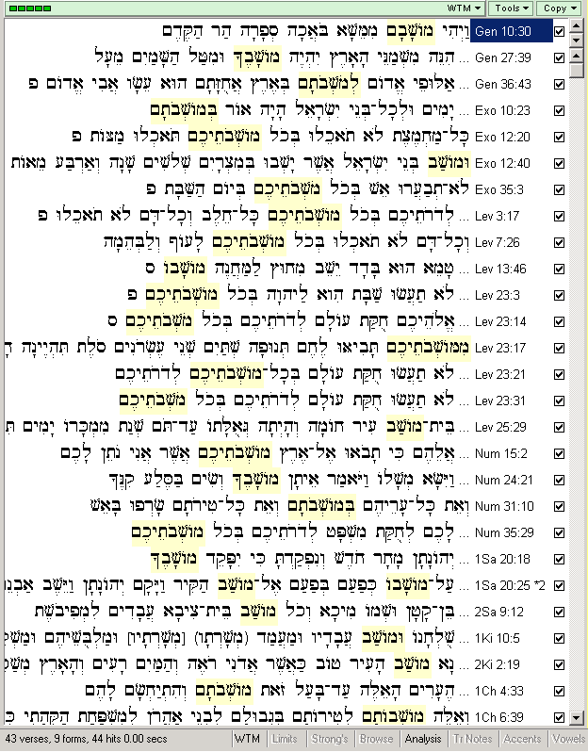
מוֹשַׁב in the Old Testament – appearances and statistics
Root:
ישׁב – to sit, to dwell
Statistics for מוֹשַׁב:
44 times
in 43 verses
in 9 forms

Slide 4
Meanings of מוֹשַׁב outside Psalm 1
dwelling place of a nation, especially Israel (most appearances)
a concrete place (outside a camp [Lev 13:46]; a city apt for dwelling [2Kings 2:19]; a place apt for dwelling [Ps 104:4.7.36]; dwelling place of God [Ps 132:13; Ez 28:2]; a place for a statue [Ez 8:3])
a place for sitting (at a table [1Sam 20:18.25], in an assembly [royal counsel [1Kings 10:5], on a square [Job 29:7], assembly of the elders [Ps 107:32])
specific meanings: a period of dwelling (Ex 12:40); an inhabitant (2Sam 9:12); a house apt for dwelling (Lv 25:29); an inhabited location (Ez 48:15)
→ now, what is the meaning of מוֹשַׁב in Psalm 1:1?

Slide 5
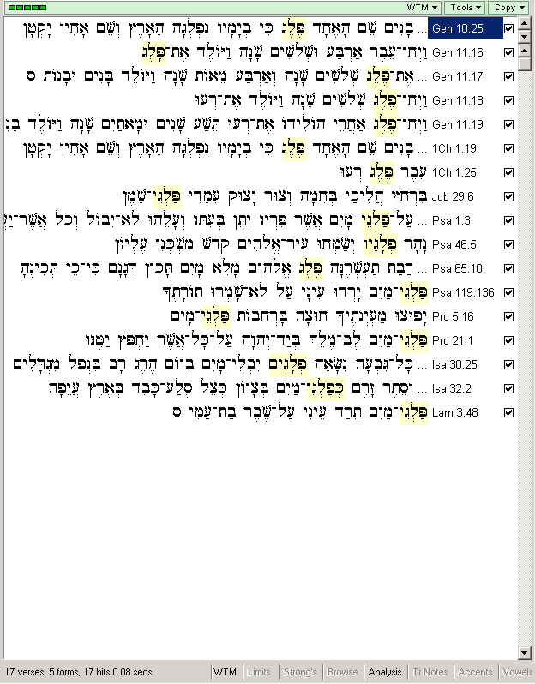
פֶּלֶג in the Old Testament – appearances and statistics
Root:
פלג – to divide
Statistics for פֶּלֶג:
17 times
in 17 verses
in 5 forms

Slide 6
Meanings of פֶּלֶג outside Psalm 1
often in connection פַּלְגֵי מָיִם „streams of water“; in Job 38:25 „streams of oil“
in a translated sense of streams of water pouring out of eyes: weeping (Ps 119:136; Lam 3:48)
often we can find other parallel expressions like: נָהָר („river“, Ps 46:5); יָבָל („watercourse“, Isa 30:25)

Slide 7
Other terms from the same root פלג
Verb: פלג
Piel and niphal: to divide, and to be divided (Gen 20:25; Job 38:25; Ps 55:10)
Proper name: פלג
Peleg (Gen 10:25; 11:16.17.18.19; 1Pa 1:19.25)c
Nouns:
-

Slide 8
The root פלג in other Semitic languages:
The root פלג appears in the OT as both a verb and a noun, with several derivatives. It is also found in Middle Hebrew, Jewish Aramaic and Egyptian Aramaic, Palmyrene, Nabatean, Samaritan, Syriac, Christian Palestinian, and Mandaic texts, as well as in Akkadian, Ugaritic, Phoenician, Arabic, Ethiopic, and Coptic sources. Taking the basic notion of division as its point of departure, ancient Near Eastern usage exhibits semantic bifurcation: (a) the predominant meaning "divide" or "part, half," as well as the meaning "district" found in Phoenician; (b) the meaning "ditch, canal" exemplified by the Akkadian parallel palgu, which reappears in Ugaritic texts with the meaning "wadi" and again in the analogous Arab. falğ, "cleft," and falağa, "cleave," as well as Eth. falag, "wadi."
(SCHUNK, פלג, in BOTTERWECK, RINGGREN, FABRY, Theological Dictionary of the Old Testament, vol. 11, Eerdmans, p. 547)

