Slide 1
SuperMarketa – Strategic Plan Development
Business Simulator
Ing. Viktor Vojtko, Ph.D. (2019)

Slide 2
Decisions to be made
Assortment composition - low / medium / high quality, attracting different segments of customers
Average mark-up in % - determines the pricing policy, ie it is reflected in profitability and sales
Number of employees per store - customer service capacity, in the case of long cashier queues customers will be less likely to come
Change of employee wages in % - affects employee satisfaction, store capacity and costs
Reliability of deliveries (service level) in % - affects the availability of goods to customers and thus sales, and also affects the cost of acquiring goods
Safety stock - none / small / medium / high, determines the amount of inventory in the warehouse and thus the tied funds
Investments in the appearance of stores - it influences the demand in selected segments, the investment represents the cost
The quarterly promotion budget - it influences revenue, is part of costs

Slide 3
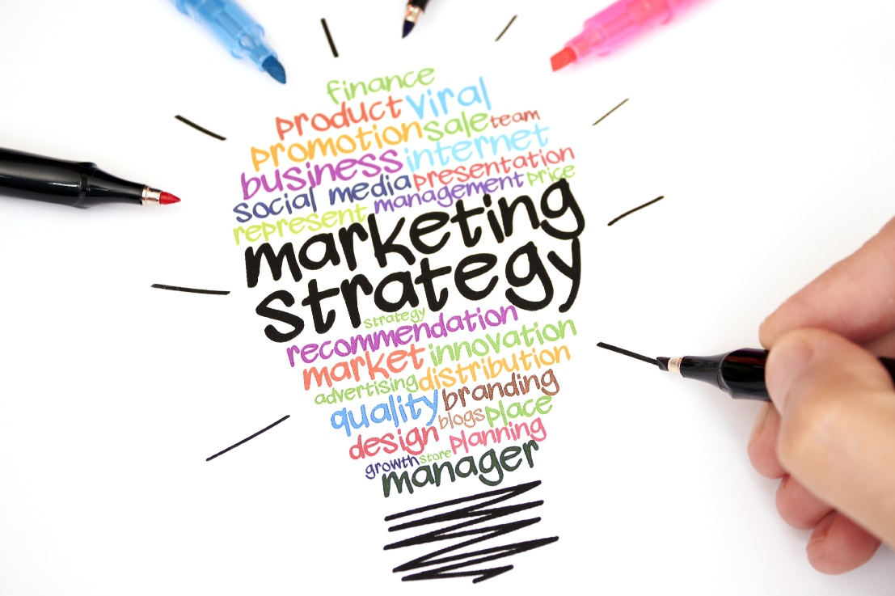
Marketing strategy
We want to attract enough of right customers according to existing segments and competitors’ position
Market targeting related decisions
Quality of assortment
Appearance of stores
Pricing (mark-up)
Promotion budget

Slide 4
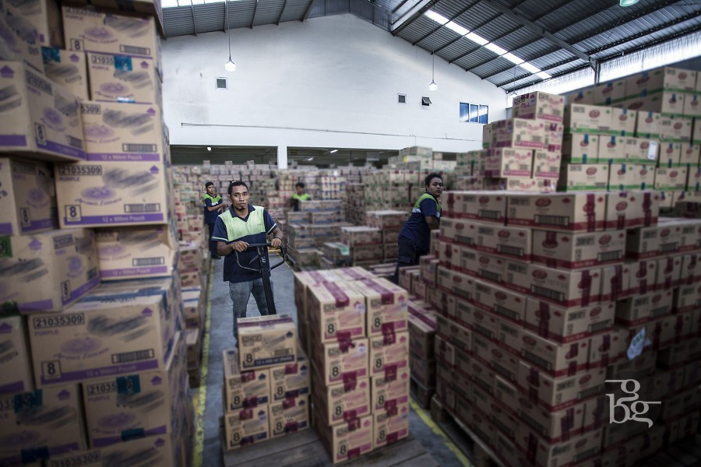
Supplier strategy
We want to have reliable enough suppliers for the least cost – it is possible to compensate their reliability for safety stock if it is favourable
Supplier related decisions:
Reliability of deliveries
Safety stock
Quality of assortment (purchasing prices)

Slide 5
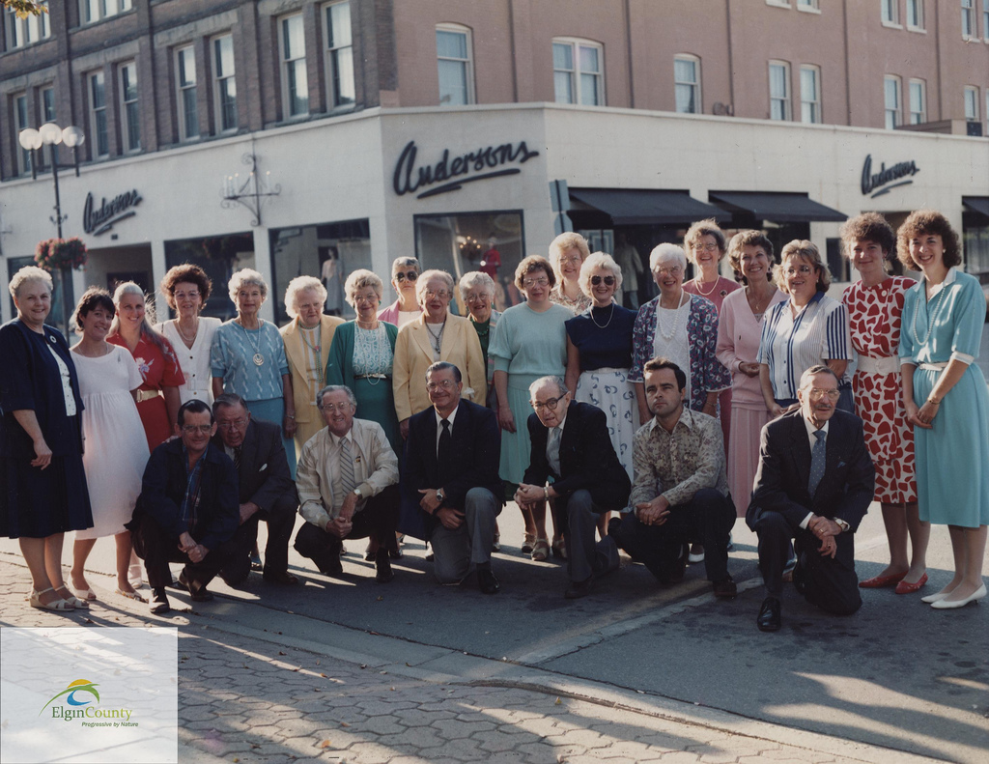
HR and operation strategy
We want to have an optimum number of employees from operational capacity perspective and give them salaries that are comparable to competition
HR related decisions:
Number of employees per store
Change of employee wages

Slide 6
Financial strategy
We want to have enough money for operations and necessary payments to suppliers as well as to minimize cost related to financial capital
We also want to achieve planned profitability for owners
Finance related decisions:
Pricing (markup)
Owners’ equity
Loans

Slide 7
Strategic plan development
We have to combine all the previous strategies together in a way when they support each other
Marketing
Supplies
HR and operation
Finance

