Slide 1
The property structure of the company
Depreciation of Fixed Assets

Slide 2
Property structure
two kinds of property:
Fixed Assets generally refers to the long-term assets. Examples of fixed assets are land, buildings, manufacturing equipment, software,…
Current Assets are important to businesses because they can be used to fund day-to-day business operations.

Slide 3
Property structure
Evidence of property: Financial statement
Balance sheet
Balance Sheet
Assets (Property) | Liabilities &Equity (Capital)
Fixed Assets | Equity
Current Assets | Long Term Liabilities (Loans)
 | Current Liabilities

Slide 4
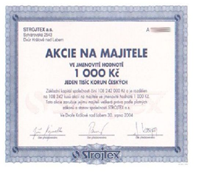
Fixed Assets

Slide 5
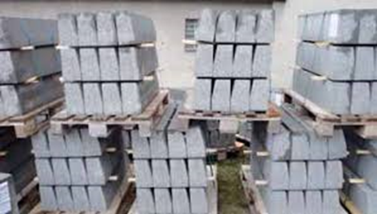
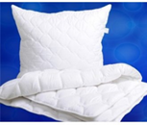
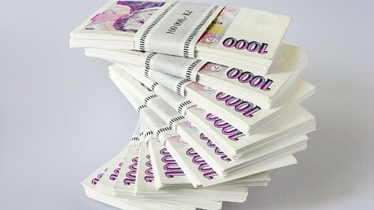
Current Assets

Slide 6
Depreciation of Fixed Assets
Through depreciation, the initial value of fixed assets is gradually being transferred to operating costs.
Depreciation
allows expressing gradual reduction in price of fixed assets.
is part of costs and therefore allows the enumeration of true operating costs.

Slide 7
Depreciation of Fixed Assets
Methods of depreciation of Fixed assets:
linear (uniform),
degressive (declining),
progressive (increasing).

Slide 8
The Linear Depreciation Method
The amount of annual depreciation is the same for each year of their useful life.
This method is one of the simplest and most frequently used.
If we do not consider the final value of FA:
where: IV – initial value of FA in CZK (initial value, or input cost
t – service life (or useful life) expressed in years,
D – annual depreciation (annual depreciation value) in CZK,
p – annual depreciation rate in %,

Slide 9
The Degressive Depreciation Method
This is characterized by decreasing annual depreciation amounts for single years of depreciation.
The methods:
The fixed-percentage method,
The „SYD method“ (Sum of the Years Digits Method)
The DDB method

Slide 10
The Progressive Depreciation Method
This is characterized by increasing annual depreciation amounts for single years of depreciation.
The methods:
The annuity method (redemption reserve method).
The decelerated depreciation method. It is somewhat analogous to the SYD method.

Slide 11
Book Depreciations
by ACCOUNTING ACT, Act No. 563/1991 Coll. on Accountancy
book depreciations are calculated from the value, at which the assets are assessed in the accounting
Accounting units shall draw up their depreciation plan

Slide 12
Tax Depreciations
by Act No 586/1992 Coll. Income Tax Law
Write-offs (Tax Depreciations) are made from tangible or intangible assets
Write-offs are defined as including depreciation of tangible assets in expenditures (costs) for the purpose of determining the income tax base.
In the first year of depreciation the entrepreneur classifies tangible assets into depreciation groups (see the annex to the Income Tax Act);

Slide 13
Tax Depreciations
Depreciation group | Depreciation period
1 | 3 years
2 | 5 years
3 | 10 years
4 | 20 years
5 | 30 years
6 | 50 years
The entrepreneur does either straight-line or accelerated depreciation.

Slide 14
Thank you for your attencion

