Slide 1
Systems Analysis and Design

Slide 2
Learning Objectives
Use Structured English as a tool for representing steps in logical processes in data flow diagrams
Use decision tables and decision trees to represent the logic of choice in conditional statements
Select among Structured English, decision tables, and decision trees for representing processing logic

Slide 3
Logic Modeling
Data flow diagrams do not show the logic inside the processes
Logic modeling involves representing internal structure and functionality of processes depicted on a DFD
Logic modeling can also be used to show when processes on a DFD occur

Slide 4
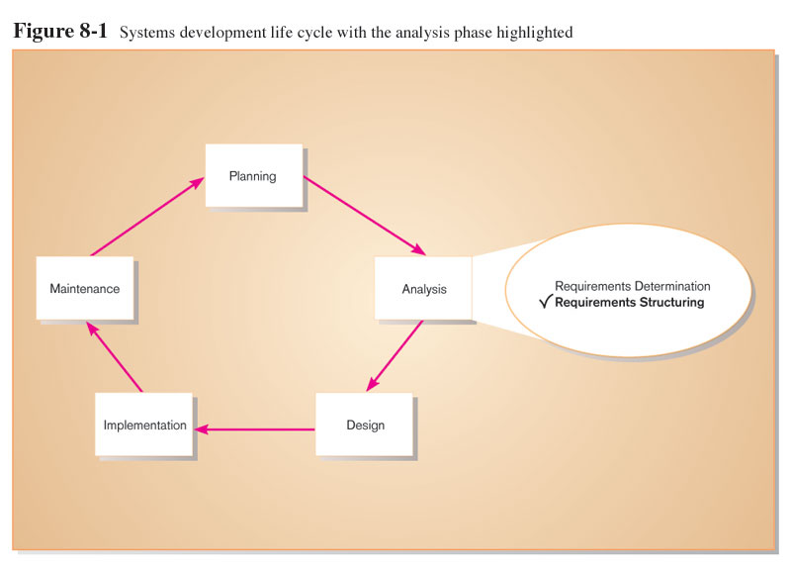
Modeling a System’s Logic

Slide 5
Logic Modeling
Deliverables and Outcomes
Structured English representation of process logic.
Decision Tables representation.
Sequence diagram.
Activity diagram
Structured English
Decision Tables
Decision Trees
State-transition diagrams
Sequence diagrams
Activity diagrams

Slide 6
Modeling Logic with Structured English
Structured English: modified form of English language used to specify the logic of information system processes.
No single standard.
Typically relies on action verbs and noun phrases and contains no adjectives or No specific standards.
Uses a subset of English
Action verbs
Noun phrases
No adjectives or adverbs
No specific standards

Slide 7
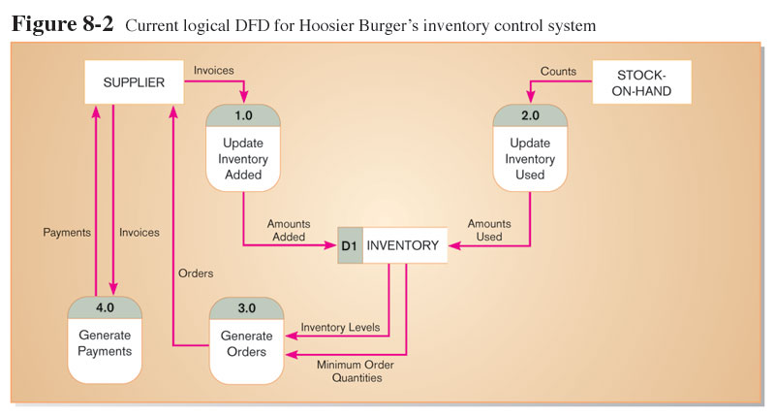
Modeling Logic with Structured English

Slide 8
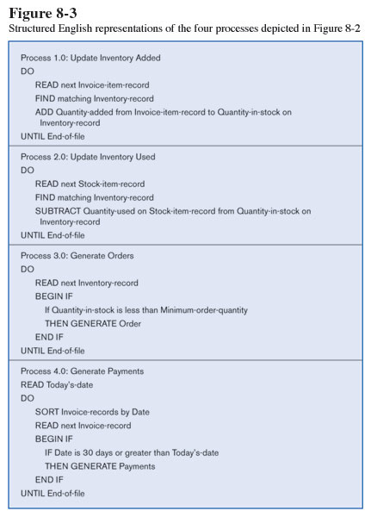
Modeling Logic with Structured English

Slide 9
Modeling Logic with Decision Tables
A matrix representation of the logic of a decision which Specifies the possible conditions and the resulting actions
Best used for complicated decision logic

Slide 10
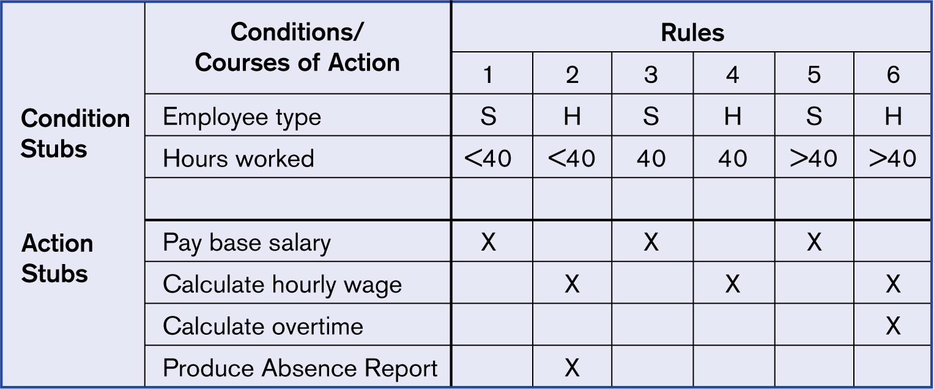
Figure 9-4 Complete decision table for payroll system example

Slide 11
Modeling Logic with Decision Tables
Consists of three parts
Condition stubs: that part of a decision table that lists the conditions relevant to the decision.
Action stubs: that part of a decision table that lists the actions that result for a given set of conditions.
Rules: that part of a decision table that specifies which actions are to be followed for a given set of condition.

Slide 12
Modeling Logic with Decision Tables
Indifferent Condition
Indifferent condition: in a decision table, a condition whose value does not affect which actions are taken for two or more rules.
Procedure for Creating Decision Tables
Name the condition and values each condition can assume
Name all possible actions that can occur
List all rules
Define the actions for each rule
Simplify the table( remove any rules which has no actions)

Slide 13
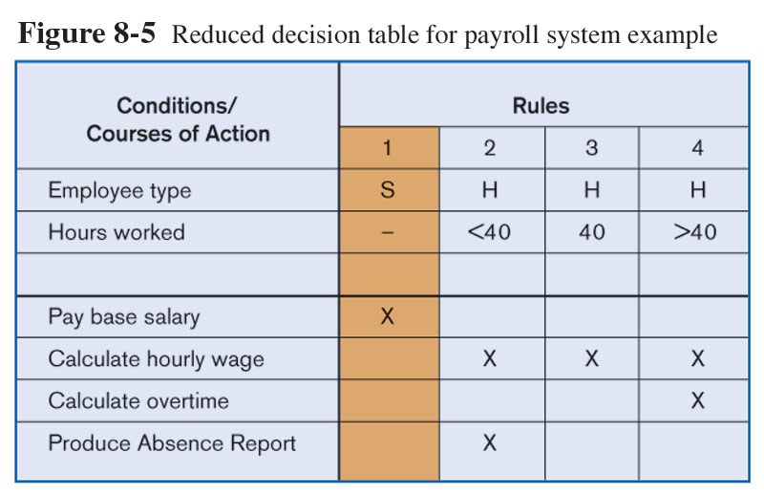
Figure 9-4 simplify decision table for payroll system example

Slide 14
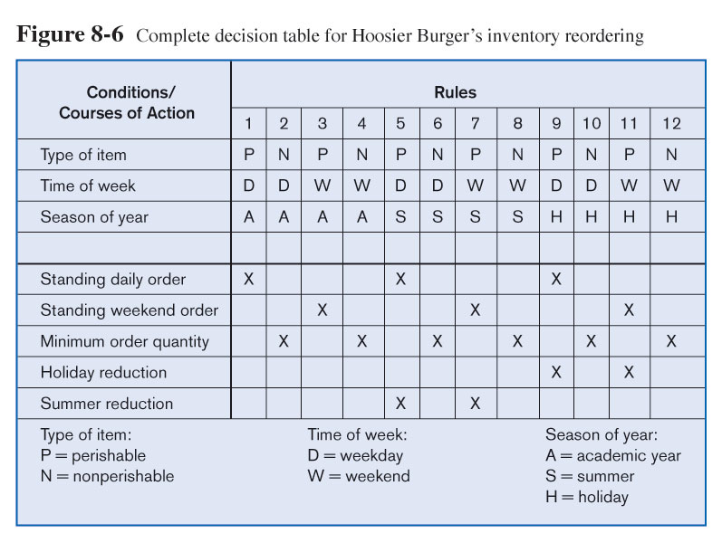
Decision Table for Hoosier Burger’s Inventory reordering

Slide 15
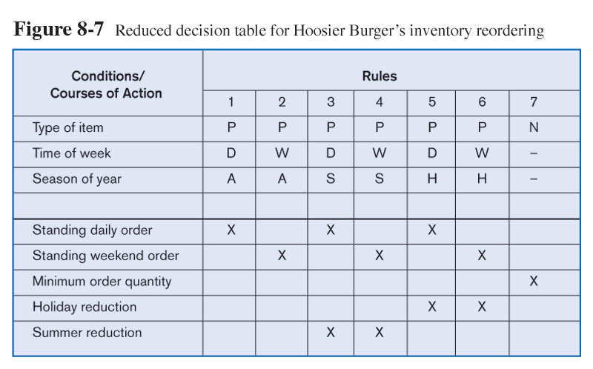
Simplified Decision Table for Hoosier Burger’s Inventory reordering

Slide 16
Modeling Logic with Decision Trees
A graphical representation of a decision situation
Decision situation points (nodes) are connected together by arcs and terminate in ovals
Two main components
Decision points represented by nodes
Actions represented by ovals
Read from left to right
Each node corresponds to a numbered choice on a legend
All possible actions are listed on the far right

Slide 17
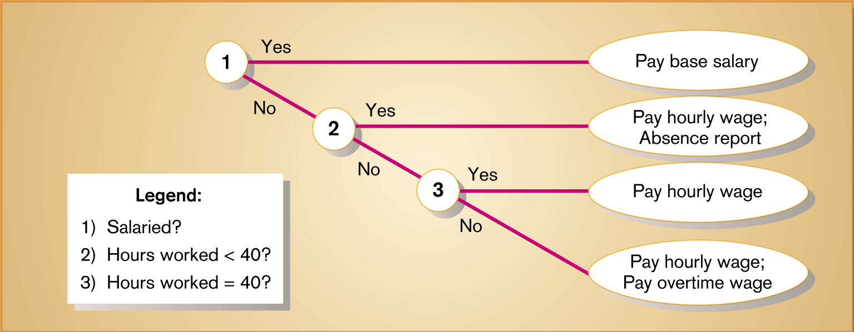
Figure 9-9 Decision tree representation of the decision logic in the decision tables in Figures 9-4 and 9-5, with only two choices per decision point

Slide 18
Deciding Among Structured English, Decision Tables and Decision Trees
Criteria | Structured English | Decision Tables | Decision Trees
Determining Conditions and Actions | Second Best | Third Best | Best
Transforming Conditions and Actions into Sequence | Best | Third Best | Best
Checking Consistency and Completeness | Third Best | Best | Best

Slide 19
Deciding Between Table and Tree
Criteria | Decision Table | Decision Tree
Portraying complex logic | Best | Worst
Portraying simple problem | Worst | Best
Making decision | Worst | Best
More compact | Best | Worst
Easier to manipulate | Best | Worst

